Slide 1
SMK Project
Variable formats / master cycles - MD

Slide 2
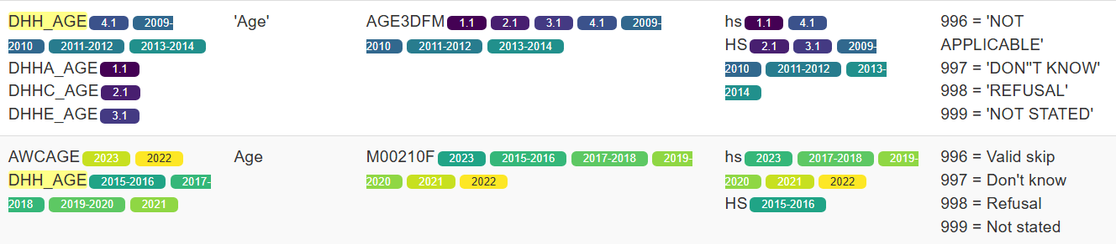
DHH_AGE
var type Continuous
Source: Data Dictionary Builder

Slide 3
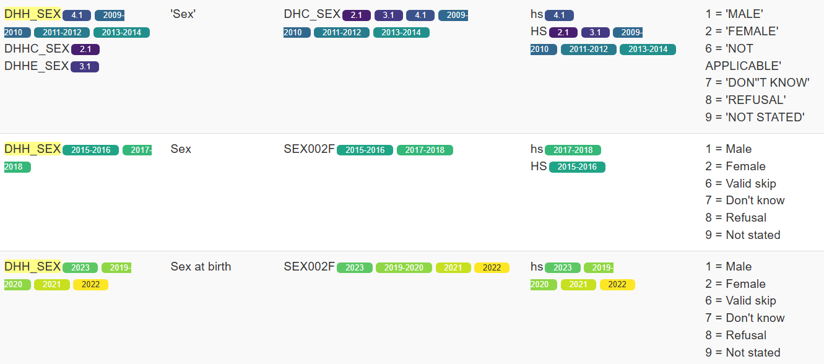
DHH_SEX

Slide 4
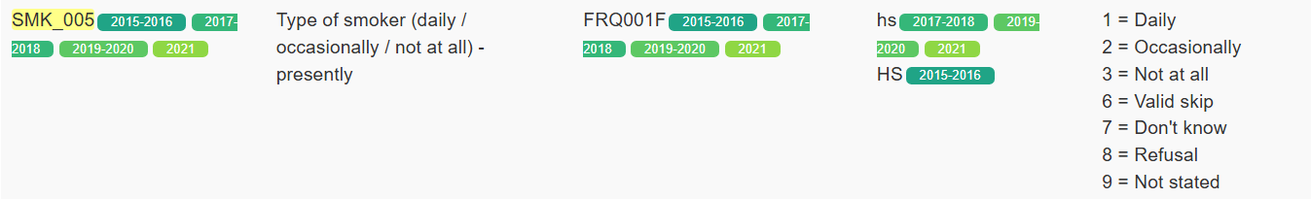
SMK_005

Slide 5
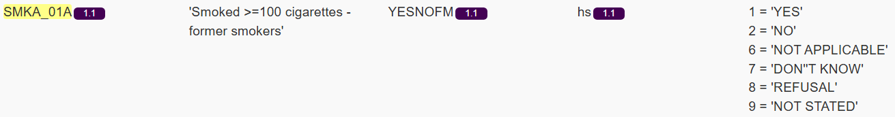
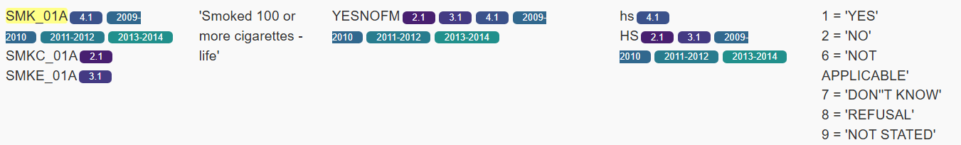
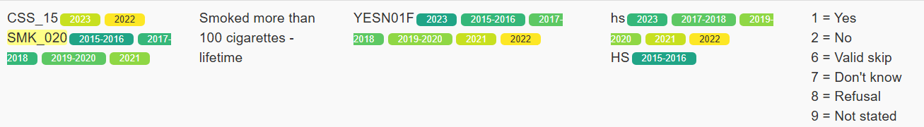
SMK_01A

Slide 6
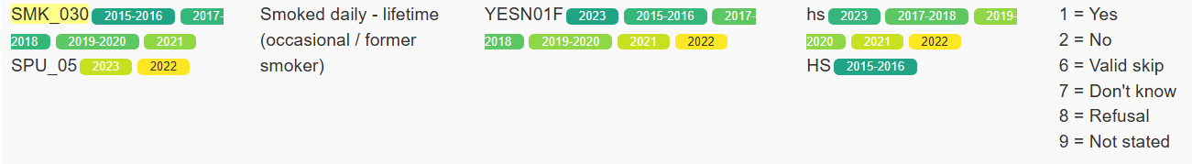
SMK_030

Slide 7
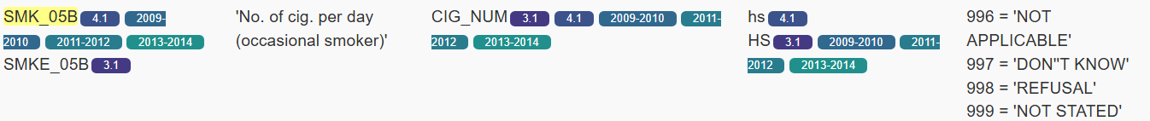
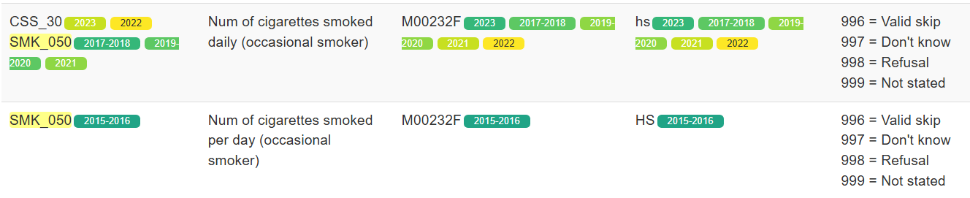
SMK_05B
var type Continuous

Slide 8
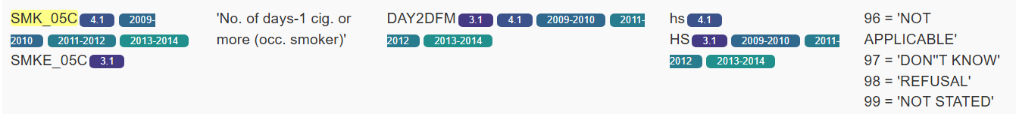
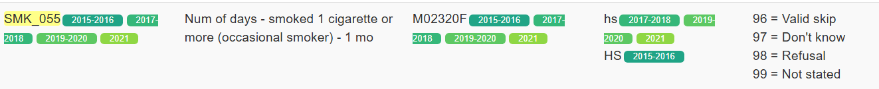
SMK_05C

Slide 9
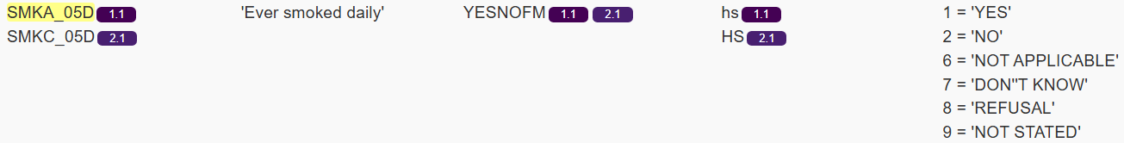
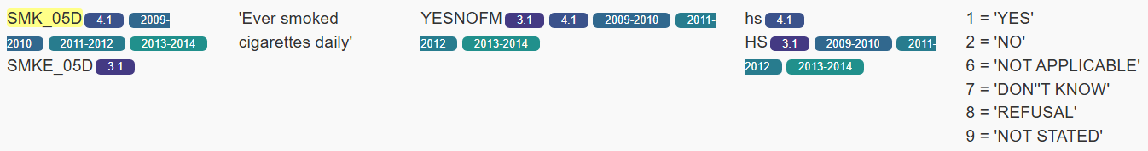
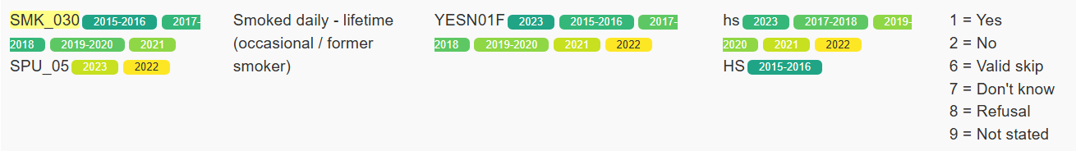
SMK_05D

Slide 10
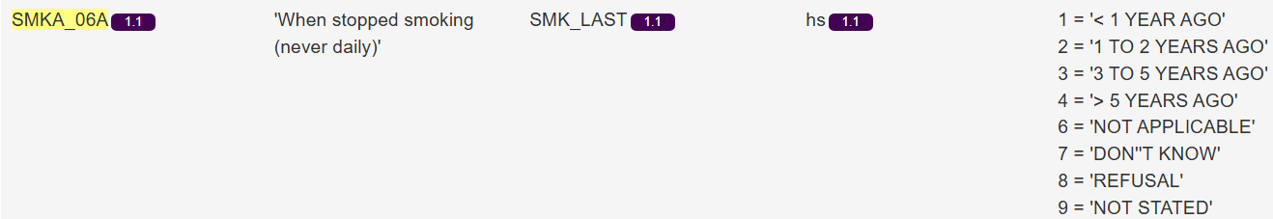
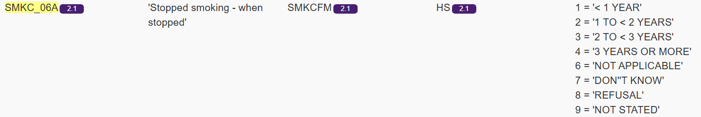
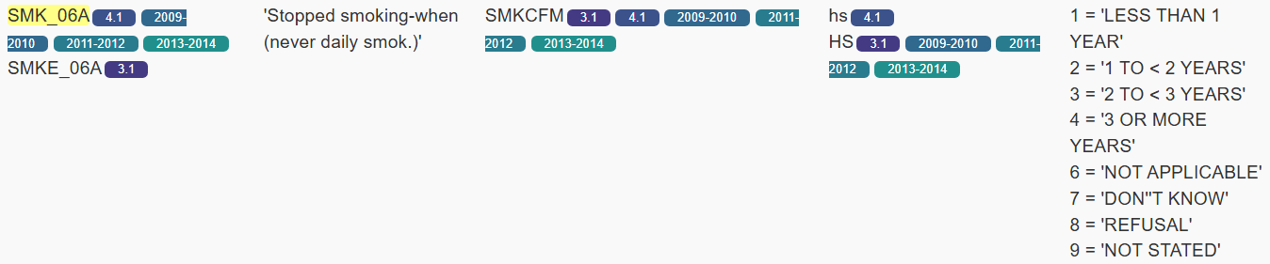

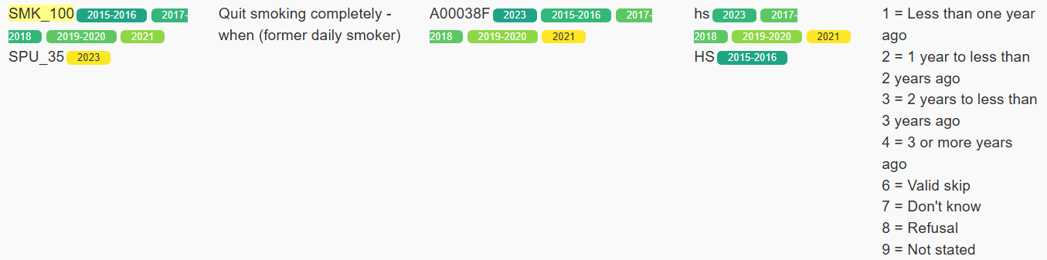
SMK_06A (version A, B, and continuous)
Notes:
SPU_35:Quit smoking completely - when (former daily smoker)
Universe: Respondents who answered SPU_30 = 2
SPU_30: Quit smoking completely - (former daily smoker)==No[2]
Universe: Respondents who answered CSS_20 = 4 and CSS_15 = 1 and SPU_05 = 1
SPU_05: Smoked daily - lifetime (occasional / former smoker) ==Yes[1]
CSS_20: In the past 30 days, how often did you smoke cigarettes? Not at all [4]
CSS_15: Have you smoked more than 100 cigarettes (about 4 packs) in your life? Yes [1]

Slide 11
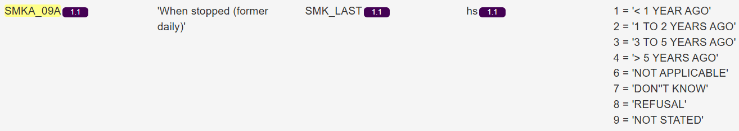
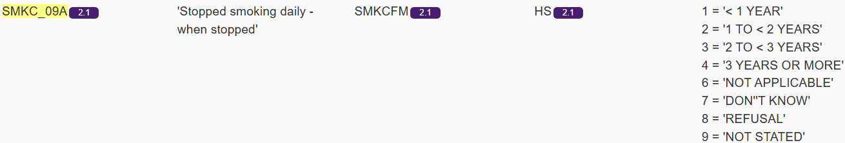
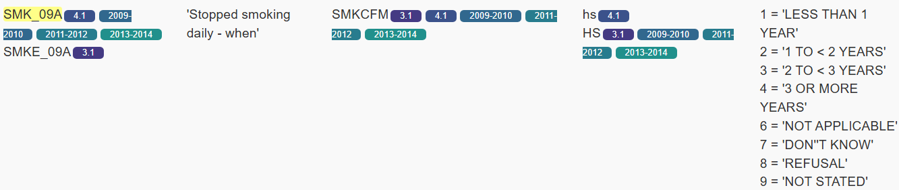
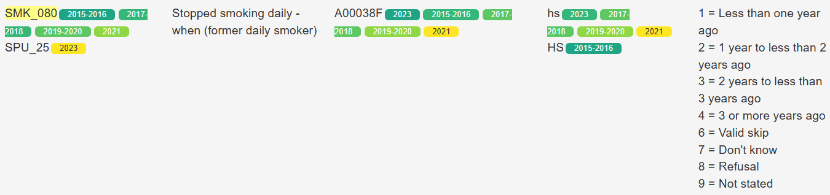
SMK_09A (version A, B and continuous)
Notes:
SPU_25: Stopped smoking daily - when (former daily smoker)
Universe: Respondents who answered CSS_20 ? 1 and SPU_05 = 1
SPU_05: Smoked daily - lifetime (occasional / former smoker) ==Yes[1]
CSS_20: In the past 30 days, how often did you smoke cigarettes? Every day[1]
We can estimate the value for the CCHS2022 cycle using SPU_25A and B.

Slide 12
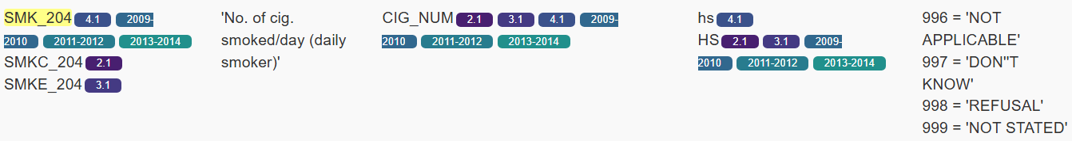
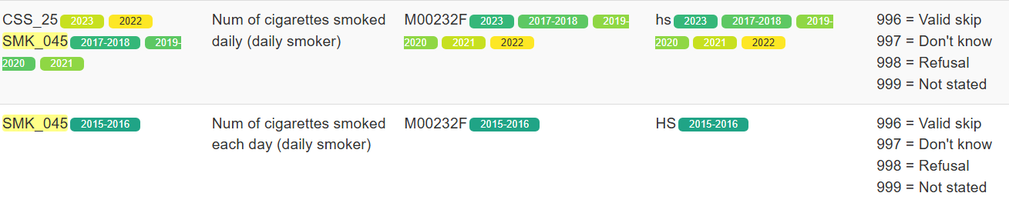
SMK_204
var type Continuous

Slide 13

SMK_208
var type Continuous

Slide 14
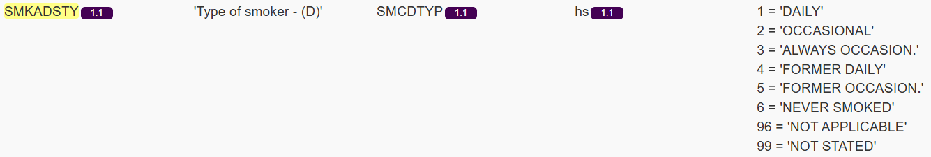
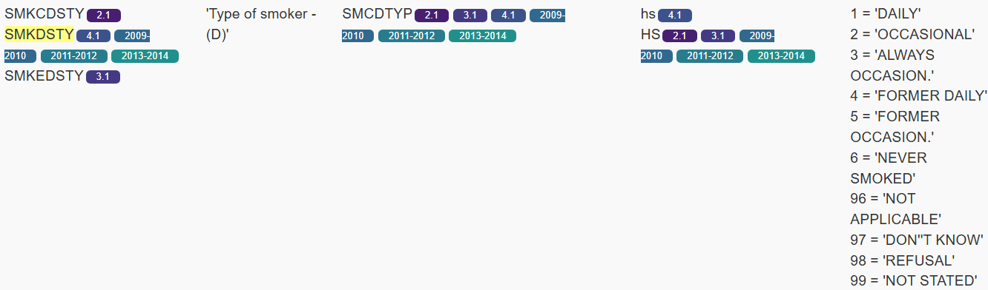
SMKDSTY_A

Slide 15
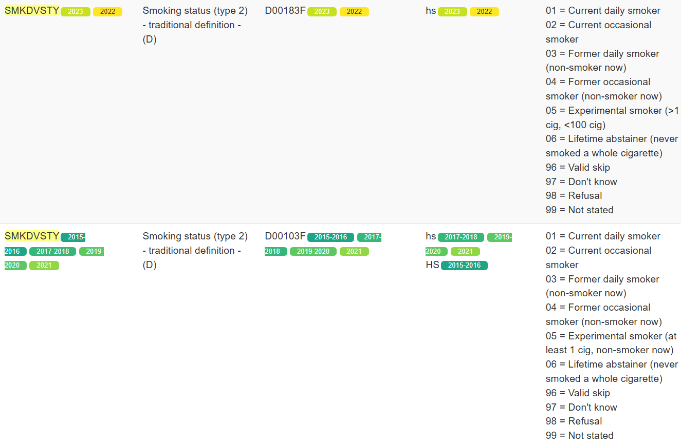
SMKDSTY_B
These cycles are not included in the xlsx file

Slide 16
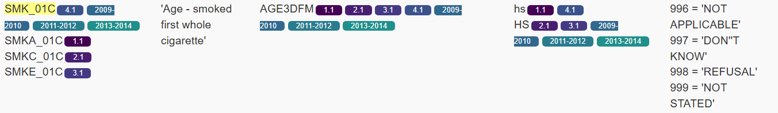
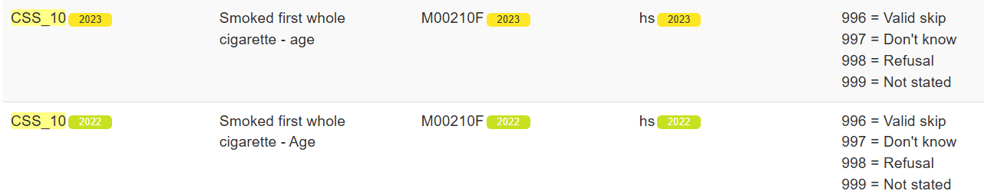
SMKG01C_cont
var type Continuous

Slide 17
SMKG040
var type Continuous

Slide 18
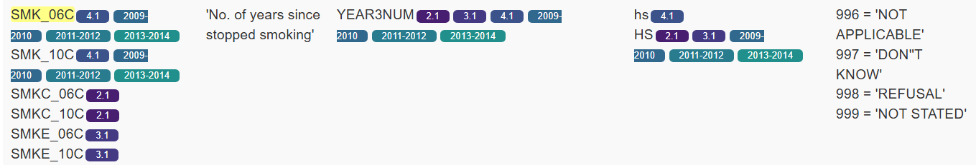
SMKG06C
var type Continuous
Notes:
Grouped by Joel's app. But SMK_10C is for former daily smokers.

Slide 19
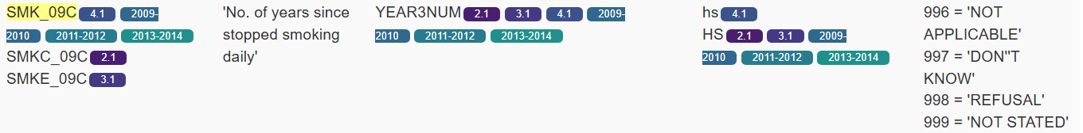
SMKG09C
var type Continuous

Slide 20
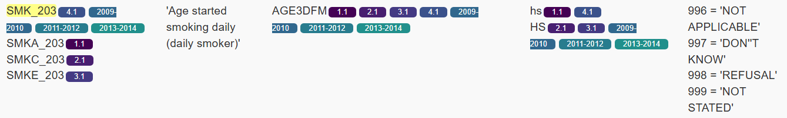
SMKG203_A
var type Continuous

Slide 21
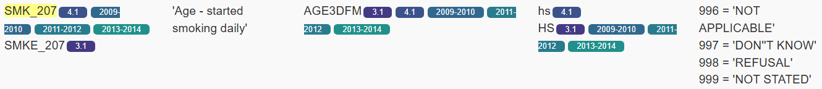
SMKG207_A
var type Continuous

